Slide 1
Nutrition ai agent
IBM AICTE PROJECT
Presented By:
Student name : Roushan Kumar
College Name & Department : B.N.M Institute of Technology

Slide 2
OUTLINE
Problem Statement
Technology used
Wow factor
End users
Result
Conclusion
Git-hub Link
Future scope
IBM Certifications

Slide 3
Problem Statement
In today's health-conscious world, people seek personalized nutrition guidance that adapts to their lifestyle, preferences, and medical conditions. However, most existing apps:
Provide one-size-fits-all diet plans
Lack adaptability and don’t respond to real-time user feedback
Ignore cultural, regional, and allergy-specific food needs
Cannot scale like human dieticians due to time constraints
Dieticians and nutritionists are unable to serve large populations continuously, which highlights the need for an intelligent, automated, and adaptive nutrition assistant.

Slide 4
Technology used
IBM cloud lite services
Natural Language Processing (NLP)
Retrieval Augmented Generation (RAG)
IBM Granite model

Slide 5
IBM cloud services used
IBM Cloud Watsonx AI Studio
IBM Cloud Watsonx AI runtime
IBM Cloud Agent Lab
IBM Granite foundation model

Slide 6
Wow factors
This project stands out due to its cutting-edge features that go beyond typical nutrition apps:
Accepts text, voice, and image inputs for ease of use
Can generate recipes from pictures of raw ingredients
Interactive nutrition details: click on any dish to see complete nutritional breakdown
Provides real-time updates based on user’s changing needs, feedback, or health updates
Offers contextual explanations like: "Why is oats better than cornflakes for you?"

Slide 7
End users
Fitness enthusiasts
People with health conditions
Dieticians and nutritionists
Everyday users

Slide 8
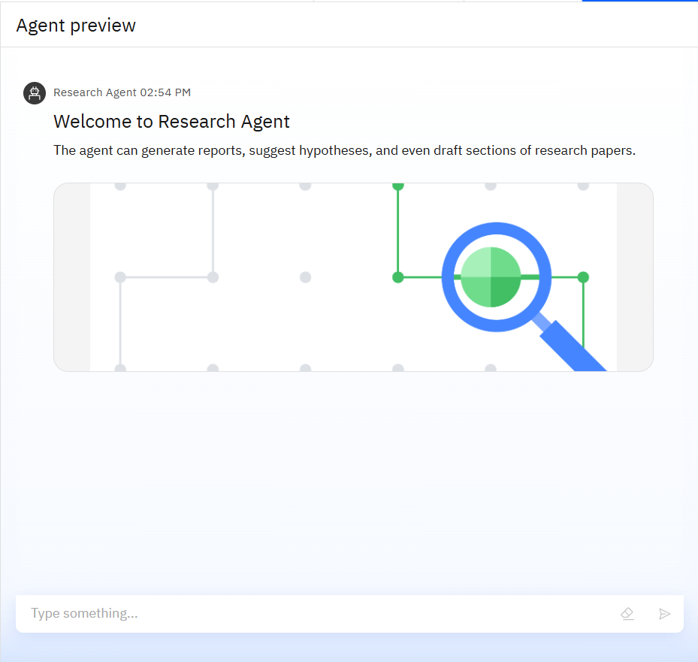
Results

Slide 9
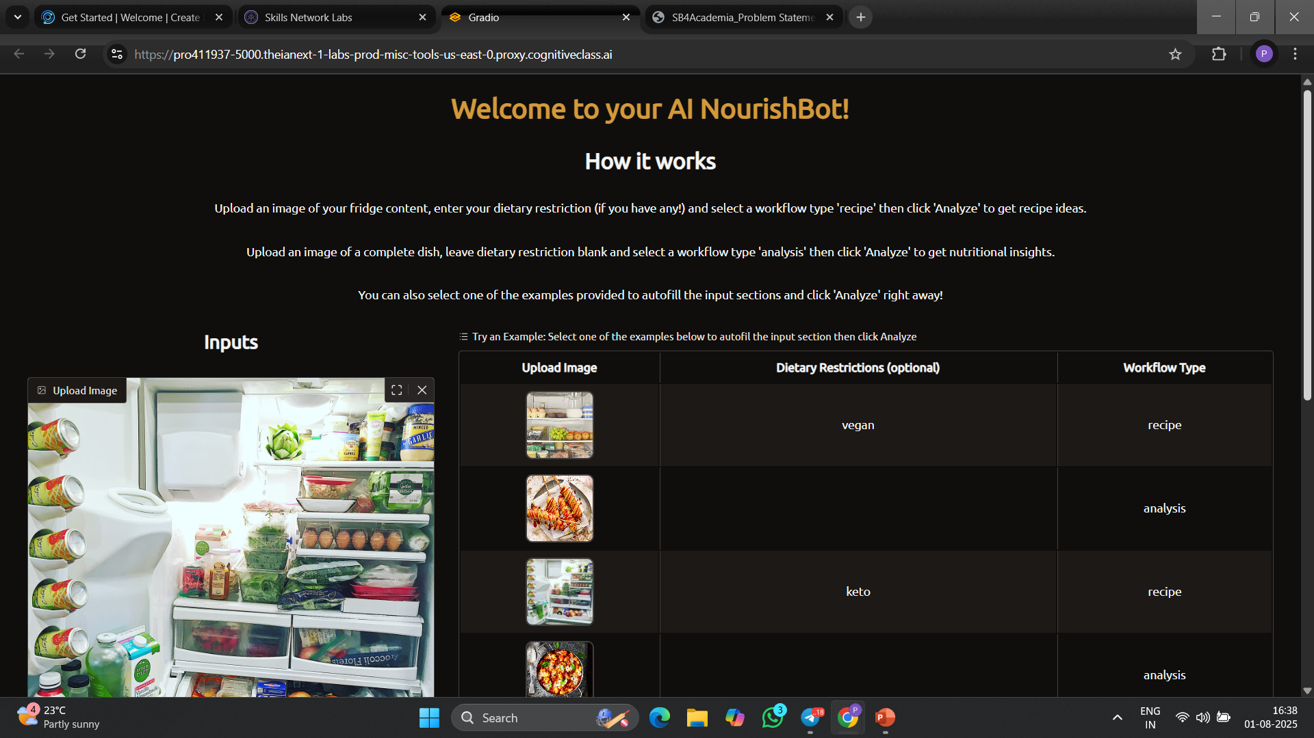
Results

Slide 10
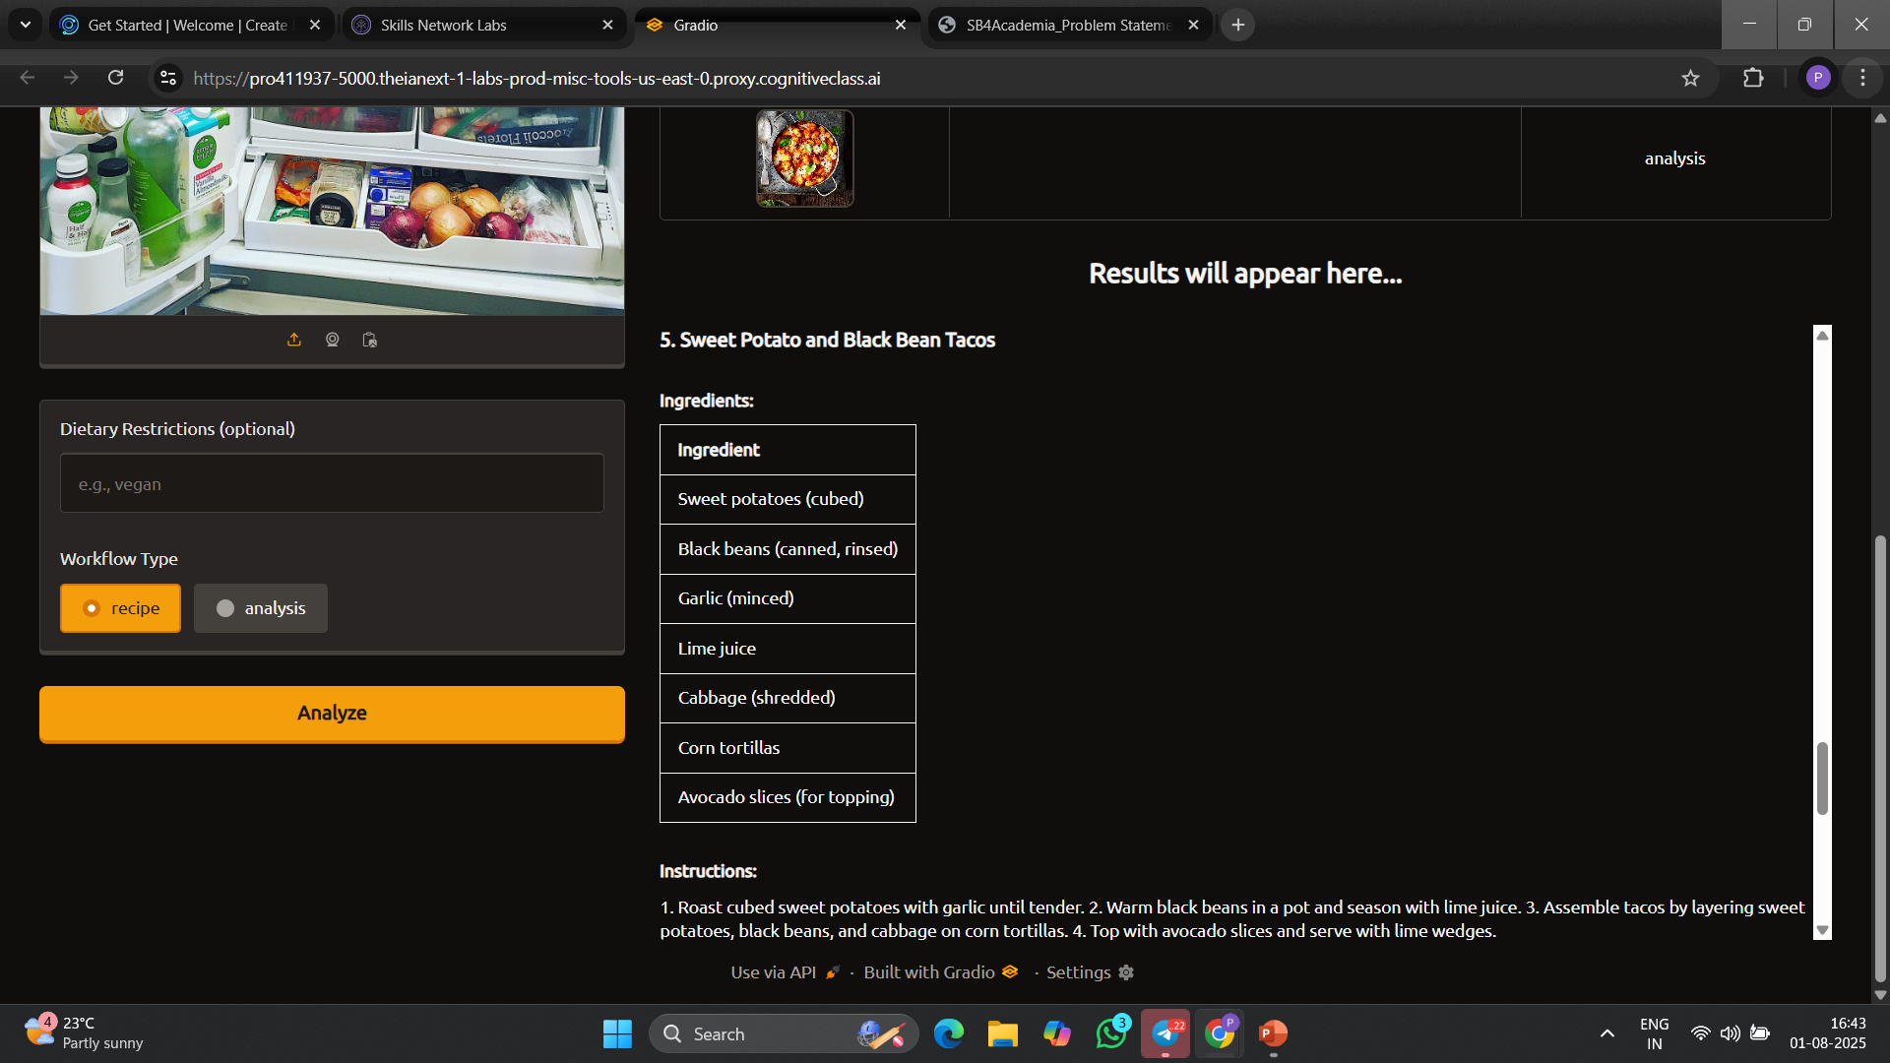
Results

Slide 11
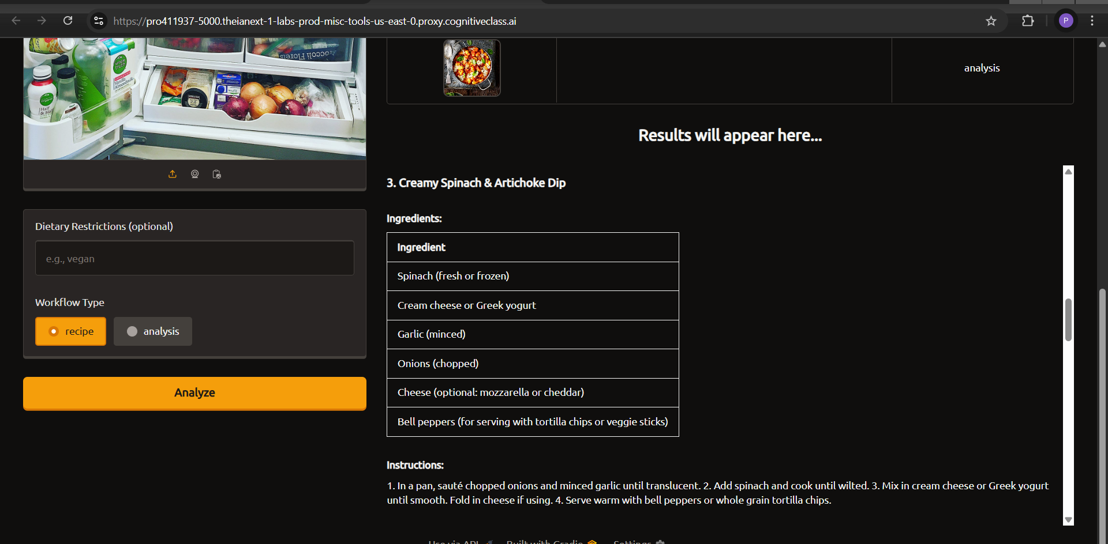
Results

Slide 12
Conclusion
Combines generative AI and cloud technology to offer expert-like guidance.
Bridges the gap between traditional diet apps and human dieticians
Offers personalization, intelligence, and scalability—all in one smart assistant
Promotes long-term healthy eating habits by providing logical, educational feedback on food choices

Slide 13
GitHub Link

Slide 14
Future scope
Multilingual support: Enable diet recommendations in local/regional Indian languagesVoice-Activated Research Assistant
Voice assistant integration: Connect with Alexa, Siri, or Google Assistant
Link to food delivery services: Order diet-specific meals directly from the app
Smart kitchen features: Detect ingredients and suggest meals from your fridge or pantry

Slide 15
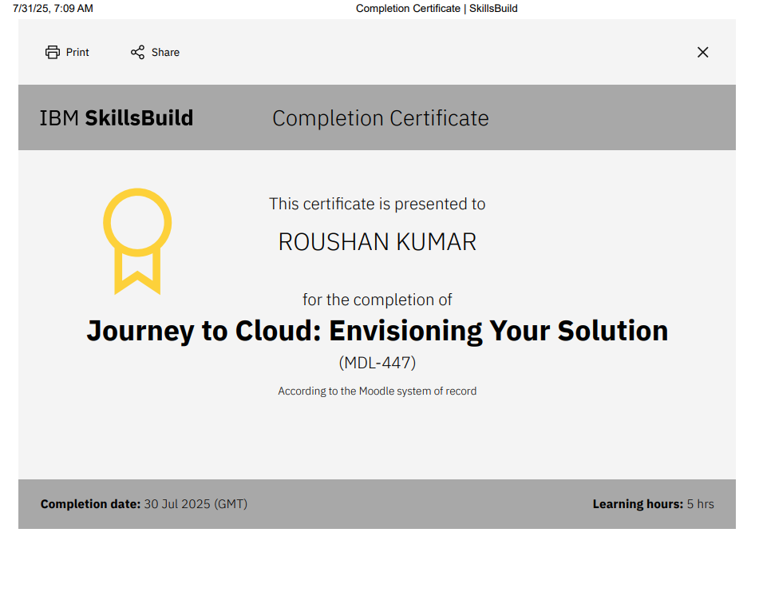
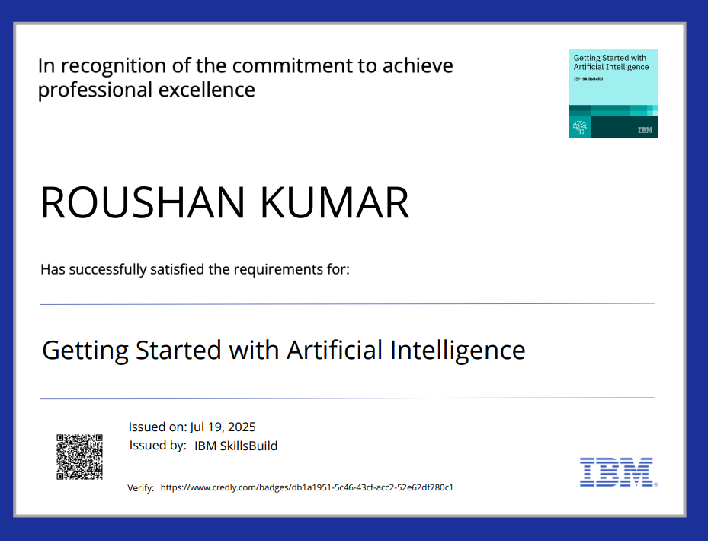
IBM Certifications

Slide 16
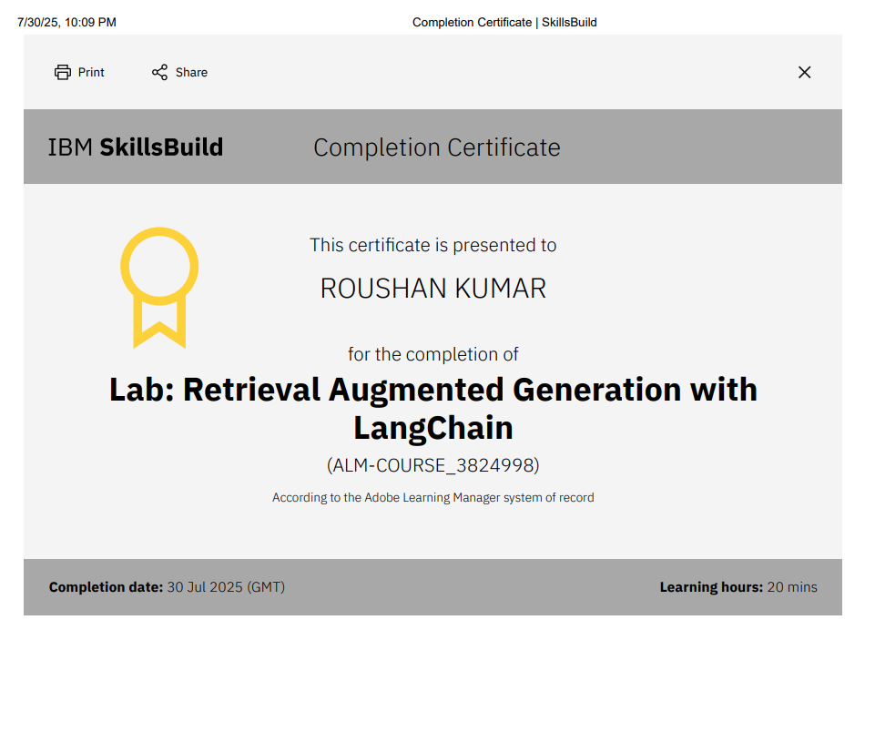
Attach your RAG LAB certificate here

Slide 17
THANK YOU

